Slide 1
Context
Eventual goal is to feed 3000 lbf, 400 psi engine, 1.4 OF, LOx & 95% ethanol
Higher thrust than team so not pumping tiny mass flow (I can only machine parts so small…), other properties similar because messing with these is not my project goal.
Goal is to not pressurize tanks whatsoever.
Reducing mass is very low priority for me, my goal is to hotfire a concept not launch a rocket.
Total (CC+GG): 4.34 kg/s lox, 3.15 kg/s fuel To Gas Generator: 11.6 g/s lox, 57.8 g/s fuel
Initial tests will be powered off an N2 bottle like you suggested.
I do not have a CAD design for a GG yet, but my concept is:
400 psi, 1360 F, 0.2 OF
Side-Outlet Reverse flow design, ¼” steel construction with 6061 injector
Central lox orifice flanked by four fuel orifices impinging on it and another four impinging on the wall (for film)
Estes motor, mounted so exhaust blows across cylindrical GG, parallel to injector face, then proceeding out GG outlet into turbine manifold. Dual purpose: igniting GG and spin starting the turbine in the meantime. Unsure about potential for clogging injector and/or turbine nozzle holes.
I plan on doing a structural, modal, and thermal FEA for the whole thing
Large reason I’m contacting you now is to get feedback on design before I launch into this analysis too far.
I’ve been working on this on and off for a bit over one year. Most of that time has been spent developing an all-encompassing MATLAB model for the whole cycle, not just cadding the turbopump (I did most of that in the past month). Thank you for any and all feedback you may have.
I come from primarily a structures background, not a propulsion one, so don’t hesitate to point out errors that might seem obvious. There are probably a lot of gaps in my knowledge on the basics of plumbing/fluids/thermal
I have my code/cads/analysis here if you happen to want to look, but I definitely don’t expect you to do that.
https://github.com/BrendanJMorgan/Engine-Development

Slide 2

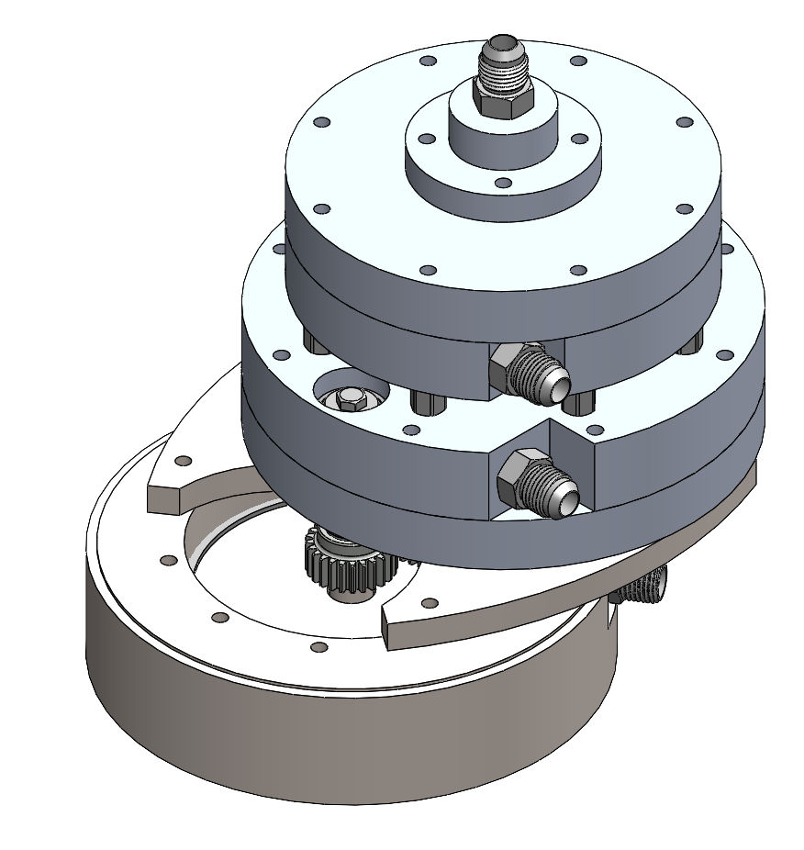
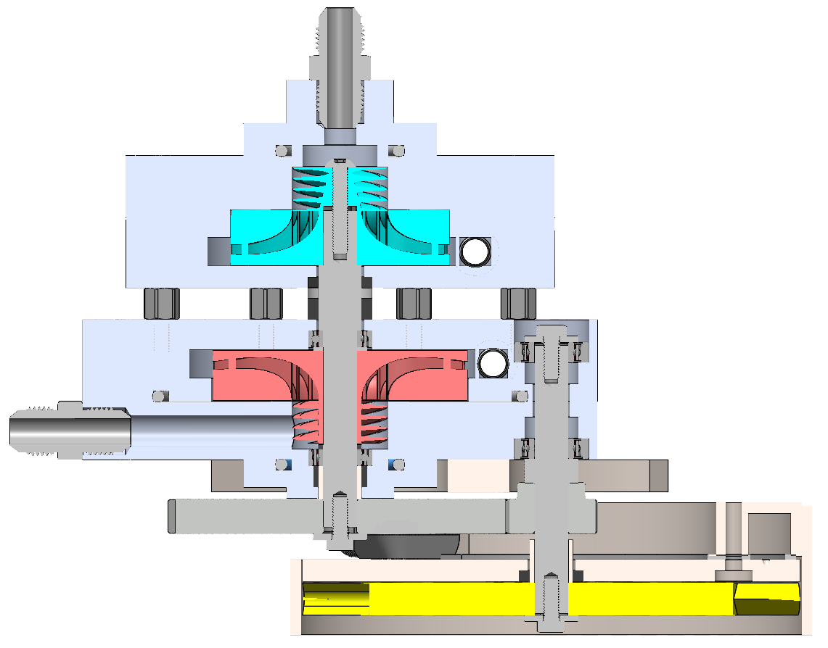
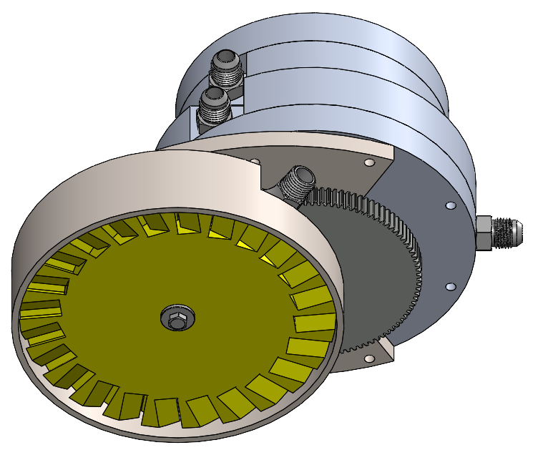
Lox In
Keyed Shafts 10 mm OD, 304 SS, Tapped Ends 10-32
GMN Angular Bearings 15º Contact
https://www.gmnbt.com/products/bb-s-61800-c-ta-angular-contact-bearing/
Lox Out
Hot Gas In
Air gaps for thermal, may put insulation sheets
Turbine Manifold
Fuel Out
Fuel In
Gears 100:25 Teeth
Module 1
80,000:20,000 RPM

Slide 3
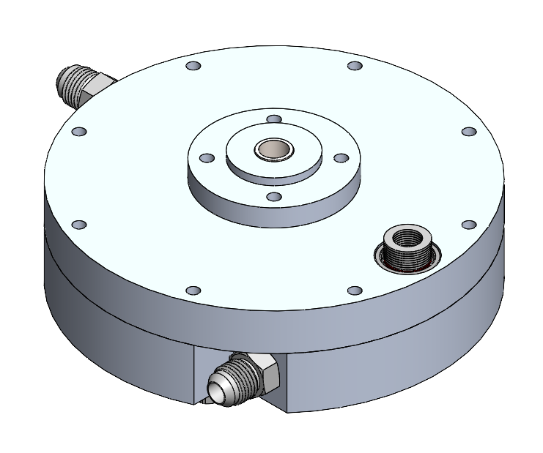
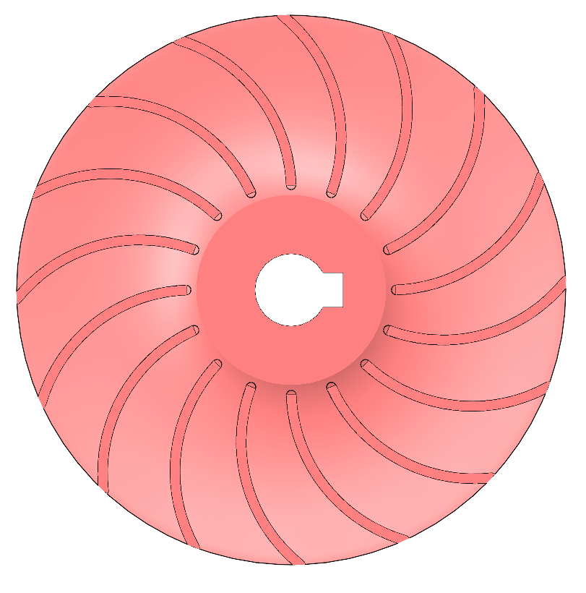
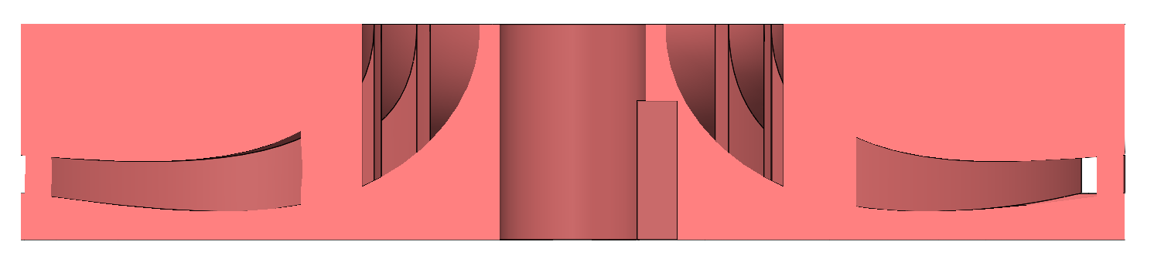
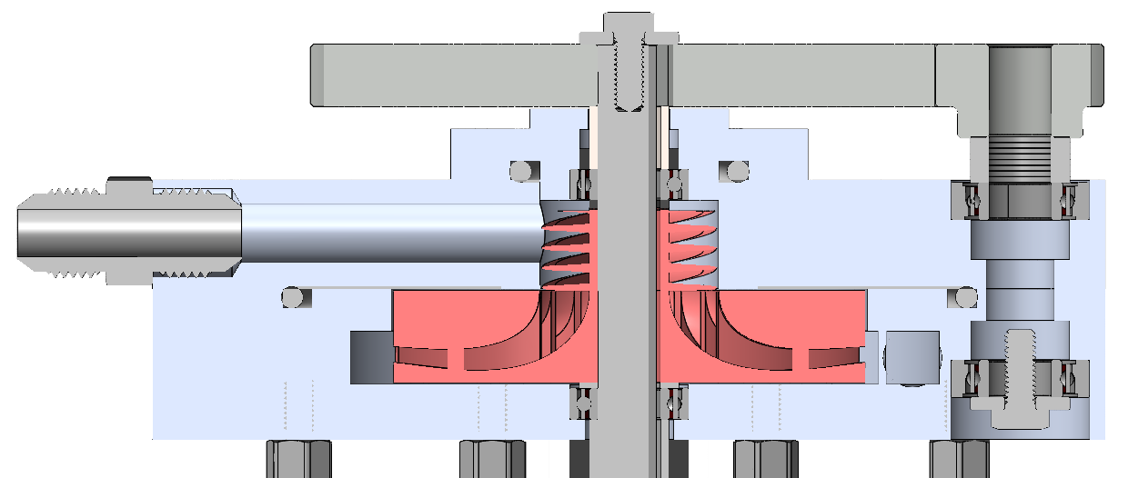
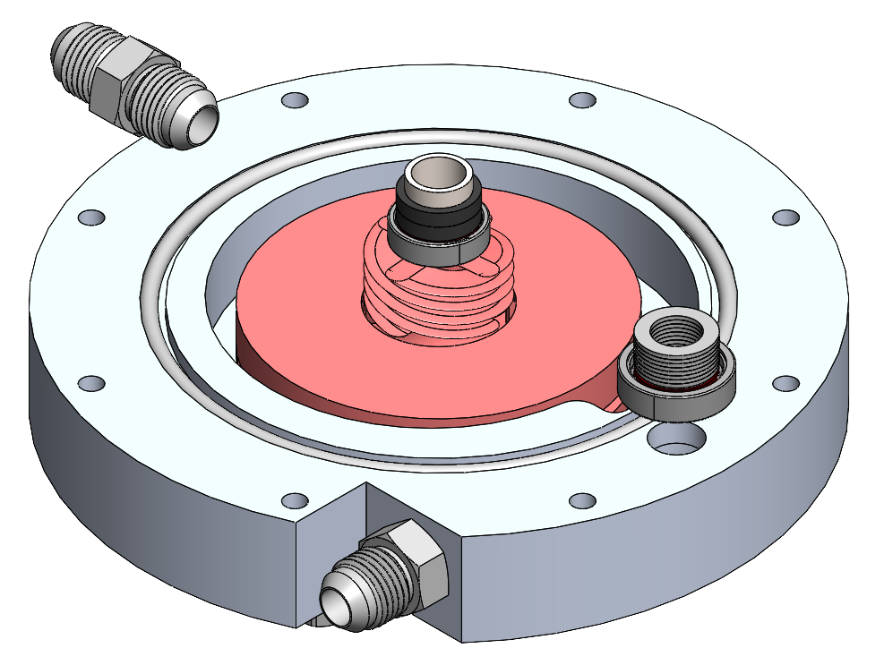
Fuel Pump
20,000 RPM, 4.99 ft-lb
Consumes 14.8 kW (71.7% hydraulic efficiency)
Designed Impeller & Volute using Pump Handbook
Inducer not fully designed yet, CAD is a placeholder
Angular Bearings Preloaded, pushed outwards
PTFE Spacer + CF Packing Seals
6” Casing OD
Turbine Shaft Mount

Slide 4
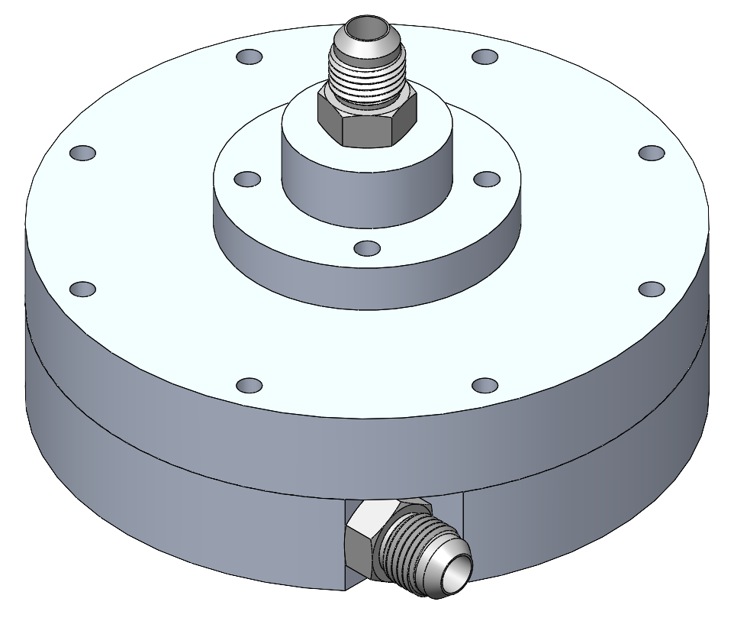
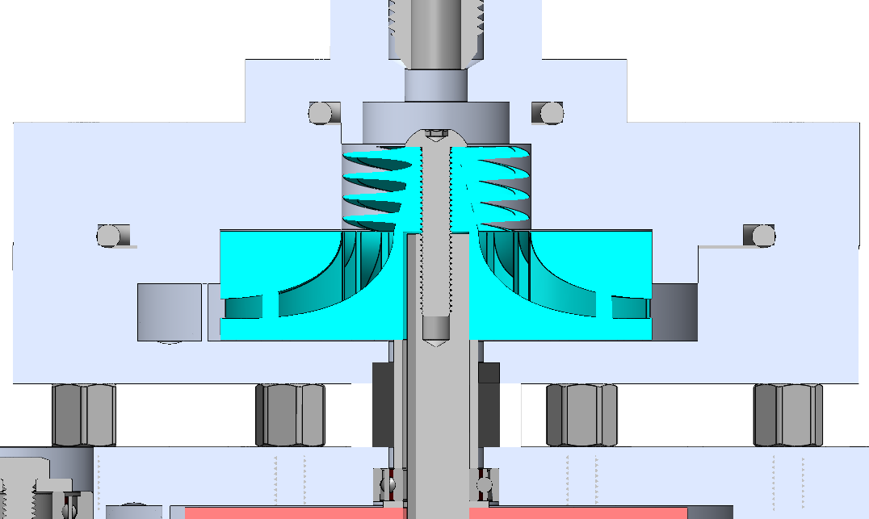
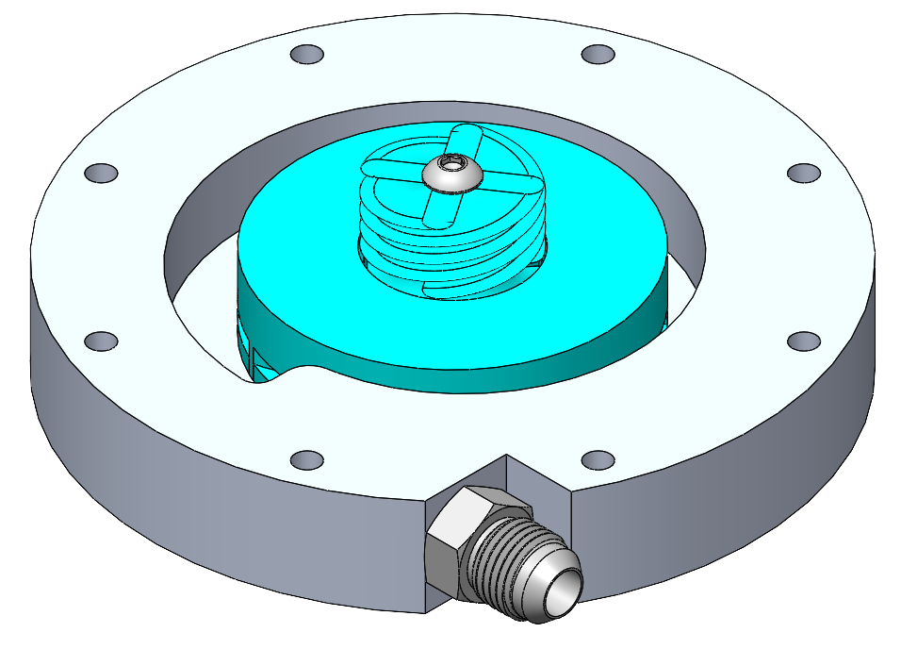
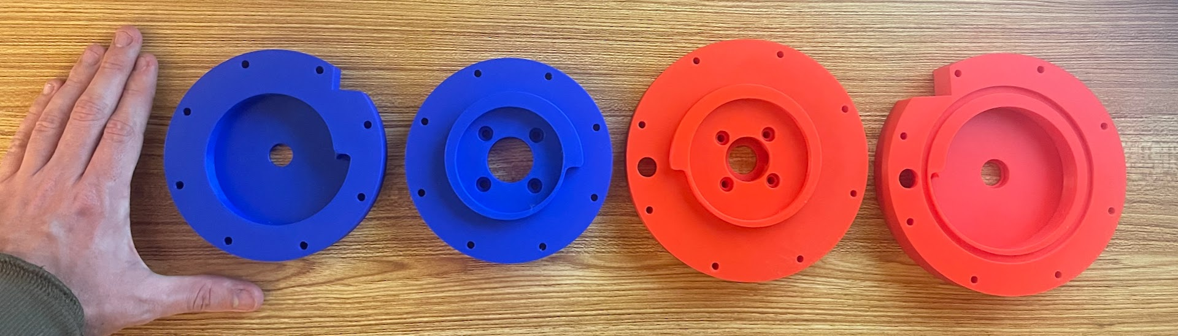
LOx Pump
20,000 RPM, 5.22 ft-lb
Consumes 14.2 kW (71.4% hydraulic efficiency)
10-32 clamps the stack onto bearing
PTFE O-Rings
Casings, Impellers, Inducers are all aluminum per your recommendation
5” Casing OD
PTFE Spacer (Under Compression), surrounding CF packing seals
3D printed pla models of lox and fuel casings with my hand for scale

Slide 5
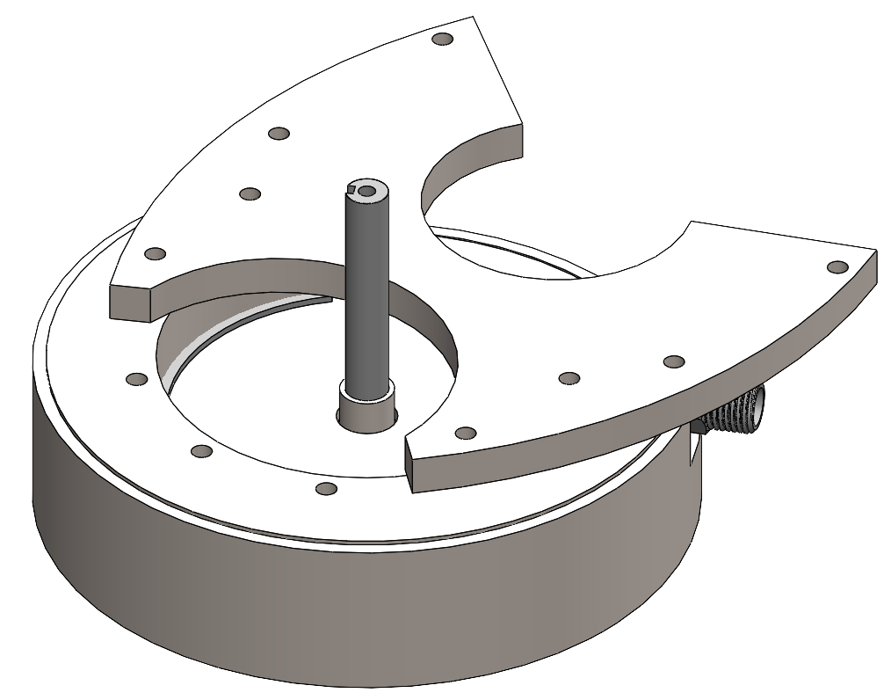
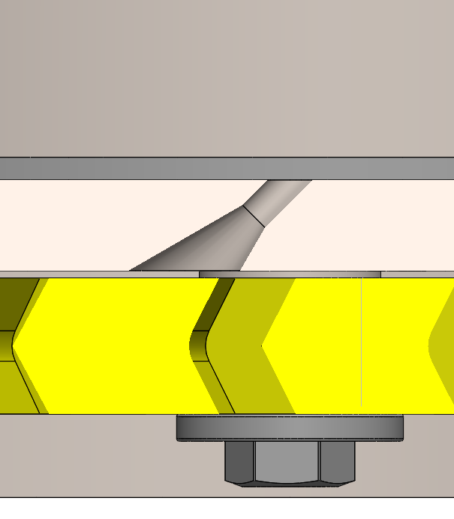
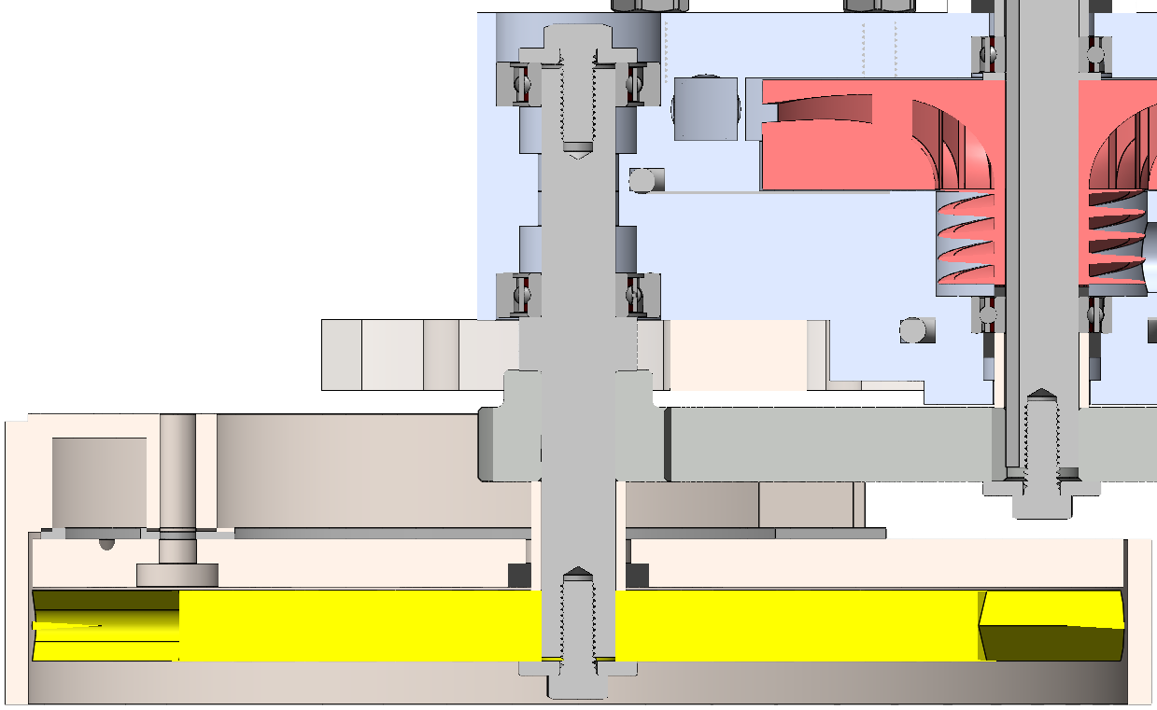
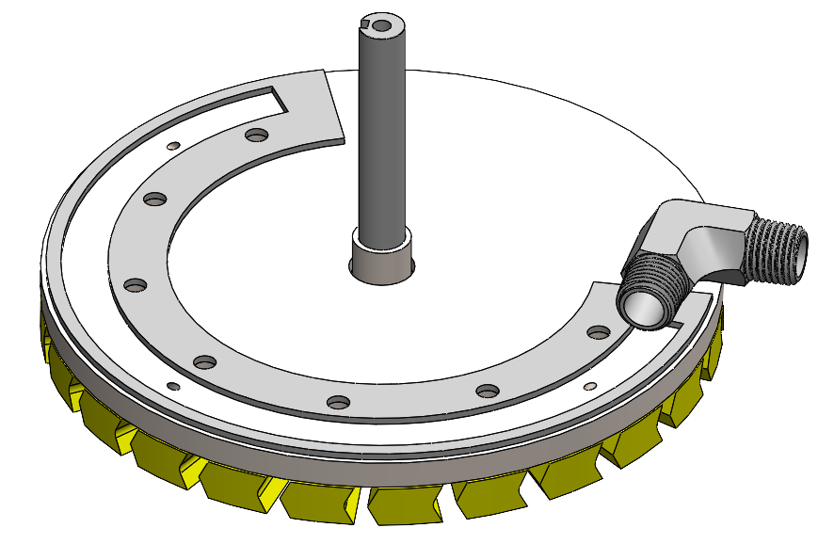
Turbine
Structural steel plate for attaching to pumps
80,000 RPM, 2.69 ft-lb
Supplies 30.5 kW (5% loss on gears?)
Everything metal here is 304 stainless.
Each nozzle has 0.088” throat, 15⁰ half angle divergence. 45º absolute angle. Plan on drilling out with a 2.2 mm bit.
I am concerned they are too tiny (i.e. hard to tolerance) but my gg’s mdot is so low I don’t know how to make them much bigger
Ceramic bearings preloaded (pulled together). Is ceramic good for the heat load?
10-32’s clamp rotor stack onto bearing
Unsure how to size manifold cross section
Graphite Gasket
Inlet from GG
Three Nozzles
CF Seal
Rotor is 3/8” 304 SS blisk. OD 5.8”, pitchline radius 2.5”
Each blade gap formed by two end mill cuts at 26.6º (relative flow angle to vertical)

Slide 6
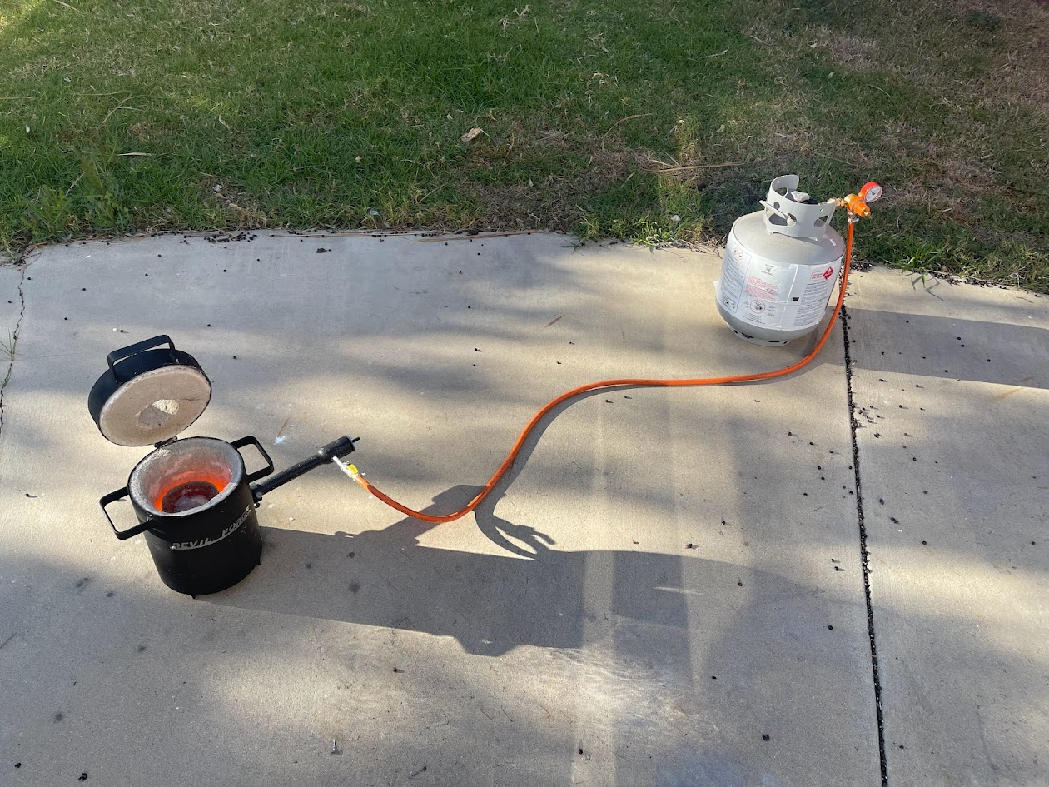
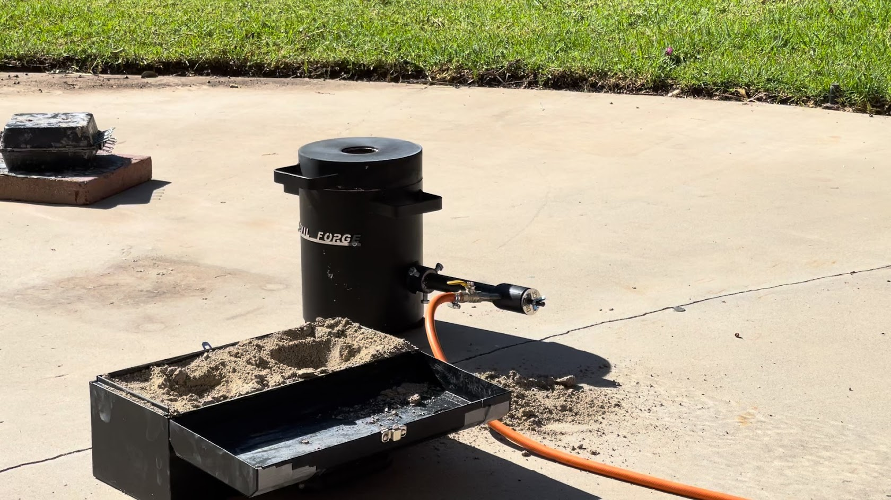
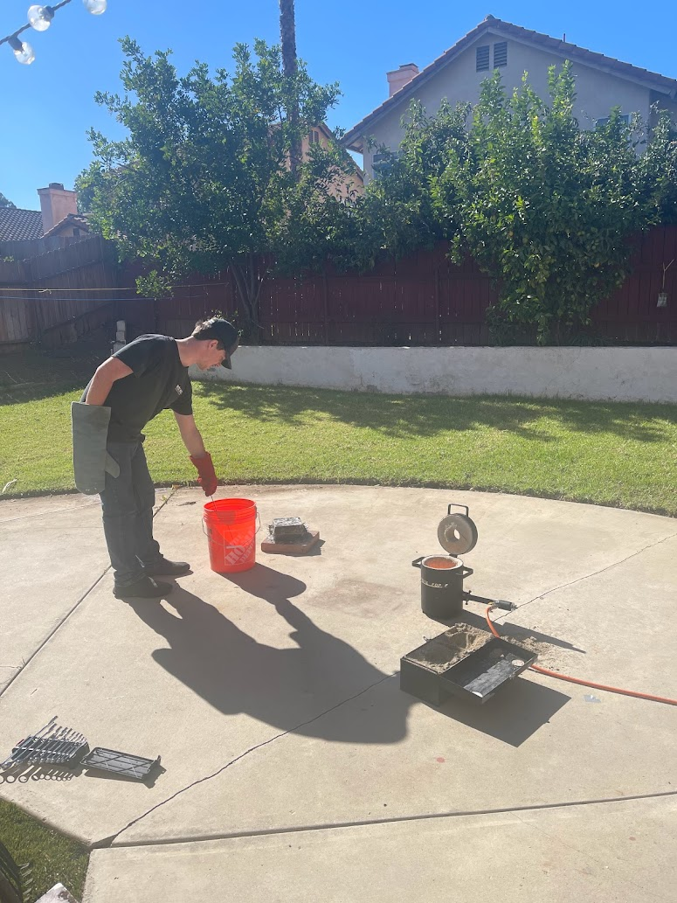
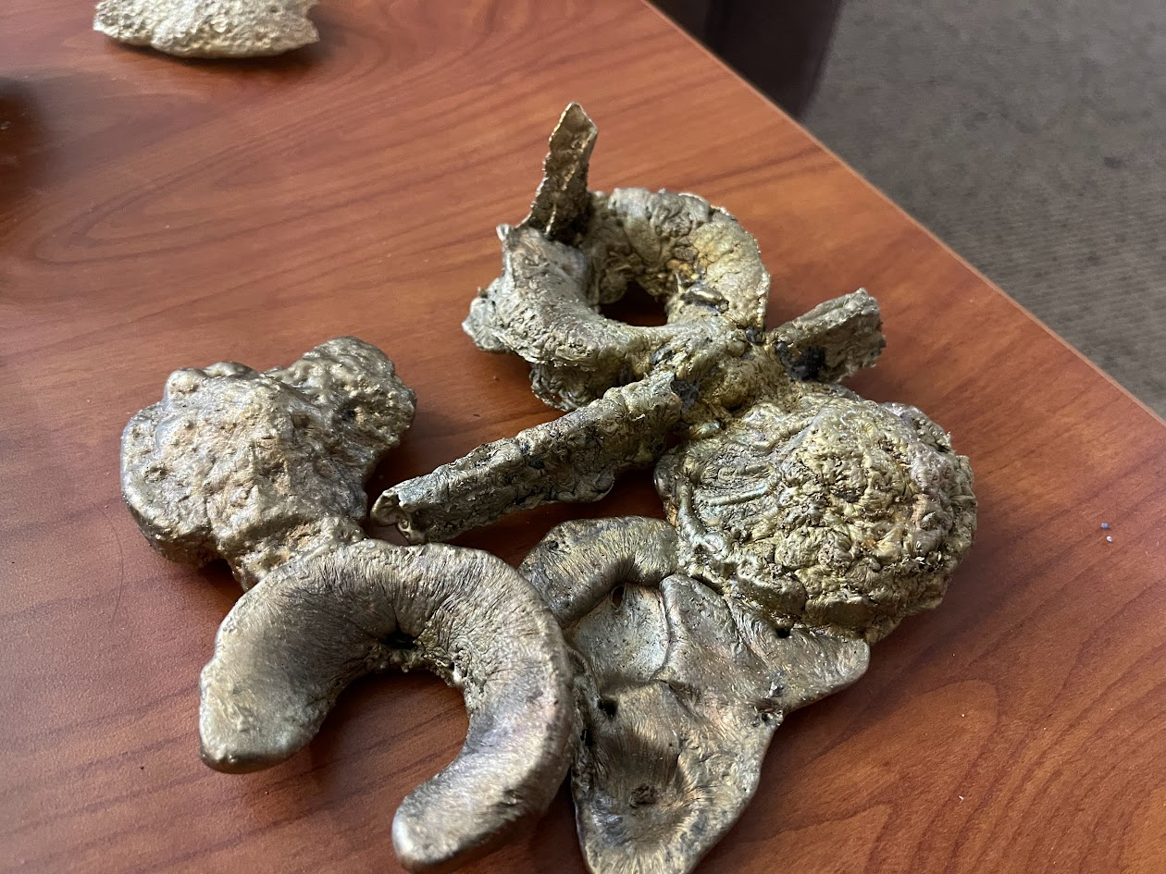
Casting
In November before I talked to you I tried sand casting my impellers in aluminum bronze.
Used greensand – I halved playsand and halved bentonite clay, with cornstarch for nonstick
Came out pretty terribly haha
In theory this is two open impellers and two shrouds connected by sprues…

Slide 7
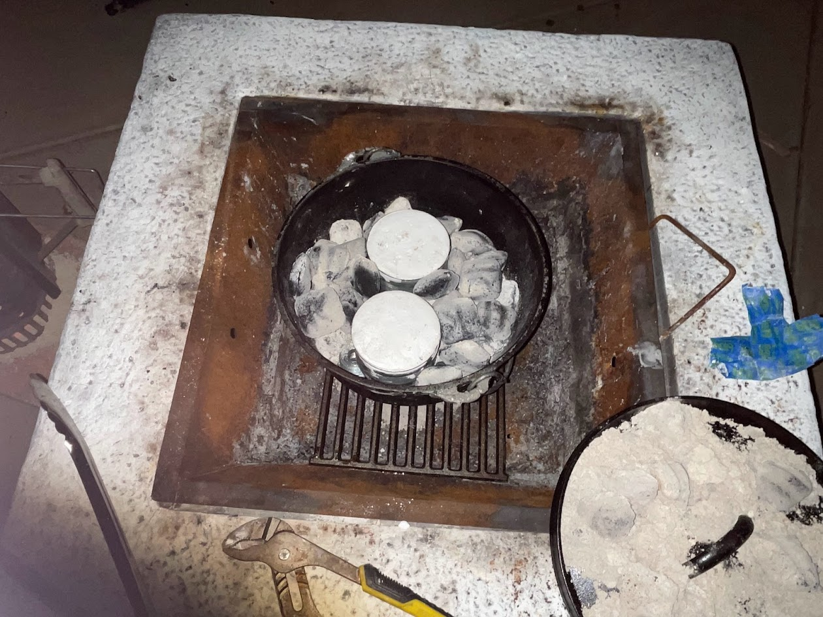
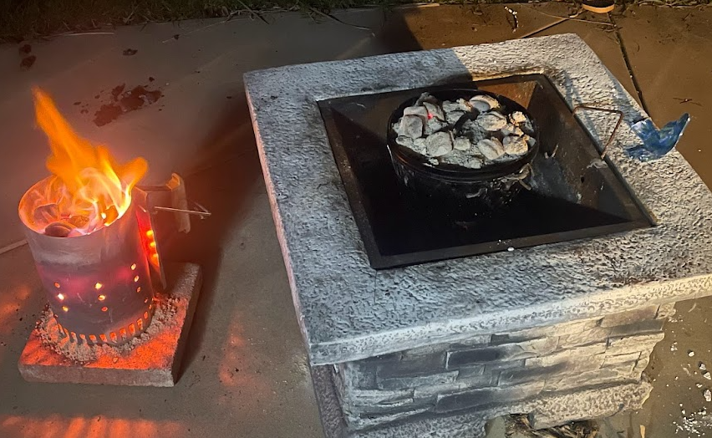
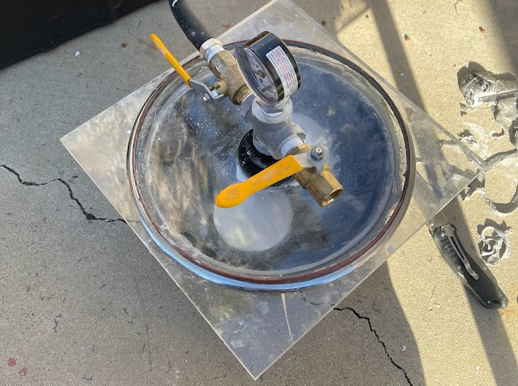
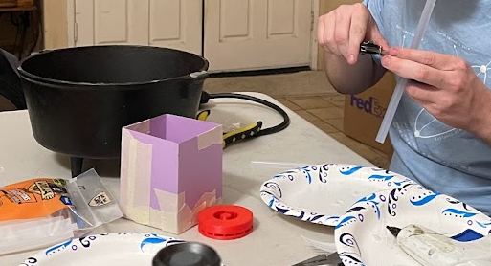
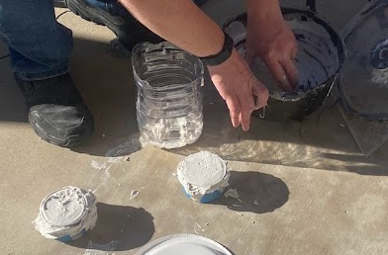
Casting
In early January I tried again, with investment per your recommendation and A357. (Though I ran out and mixed some 6061 in as well)
Vacuum chamber with investment. This stuff: https://www.amazon.com/Premium-Jewelry-Making-Casting-Investment/dp/B07SXD7PW9
PLA burnout with charcoal. Actually kinda worked but I think it may have led to the investment crumbling internally
Results were slightly better than the first time but still pretty bad. At this point I’ve given up for now and plan on outsourcing my impellers and inducers to be metal 3D printed, then return to trying casting at some later date.
That is, unless you see major errors I could fix that would lead to much better results?
I sprued the PLA prints with hot glue sticks inside soup cans

Slide 8
Major Questions
I welcome feedback on anything amiss you see, This is just what I have been thinking about most.
Seals are a top concern of mine. You suggested labyrinth seals, though it is quite hard to find a place to buy a small quantity. I opted for carbon fiber packing seals (https://www.mcmaster.com/9437K4/). They are the highest speed contact seals I could find anywhere at 4400 feet/min. My pump shaft is 2060 ft/min so I plan to use those on it, but my turbine shaft is 8250 ft/min. I’m considering using them anyways and if they burn off, so be it because it seems unlikely to me that hot gas would preferentially travel from the blades inward and up the shaft, and even if they did my turbine shaft is completely decoupled from the pumps so the hot gas can’t really damage anything (other than just heating up the pump exteriors somewhat).
Is this valid or am I off base here and should continue searching for non-contact seals?
As it stands there are no bearings at all on the lox pump; the shaft is cantilevered off the two fuel side bearings. This is because it is quite hard to find something cryo rated at my shaft speed. The two fuel bearings are preloaded (they are being pushed away from each other) so I’m hoping that will provide good stiffness for this and the 100 tooth gear, which is also cantilevered though with a short moment arm.
Would this probably be stiff enough in your experience?
I have no idea what my clearances should be. In my CAD right now there's about 10-20 thou around the impellers on all sides, should I go higher?
Same questions on the turbine shaft, which is preloaded oppositely (bearings pulled toward each other)
Is there much advantage of ceramic bearings over stainless steel ones? GMN has both for my size but it’s unclear what would best apply to my case.
I went with a geared design because otherwise my rotor has a ~20” pitchline radius, which is prohibitively large for me to buy, machine, and integrate. Though I have little experience with gears.
Is gearing at these speeds practical in your opinion/experience?
I chose spur gears so I didn’t have to deal with thrust on a helical. Should I be concerned about excessive vibration and/or wear?
Should I be concerned about the effect of turbine heat load on the lubrication?
This is more minor but I’ve often heard gears should have a coprime number of teeth. Is this a real concern or a nice-to-have? The 100 and 25 tooth gears were the most practical I could find from KHK.

